Slide 1
HR Attrition Analytics
File created on: 10/23/2023 9:02:43 AM

Slide 2
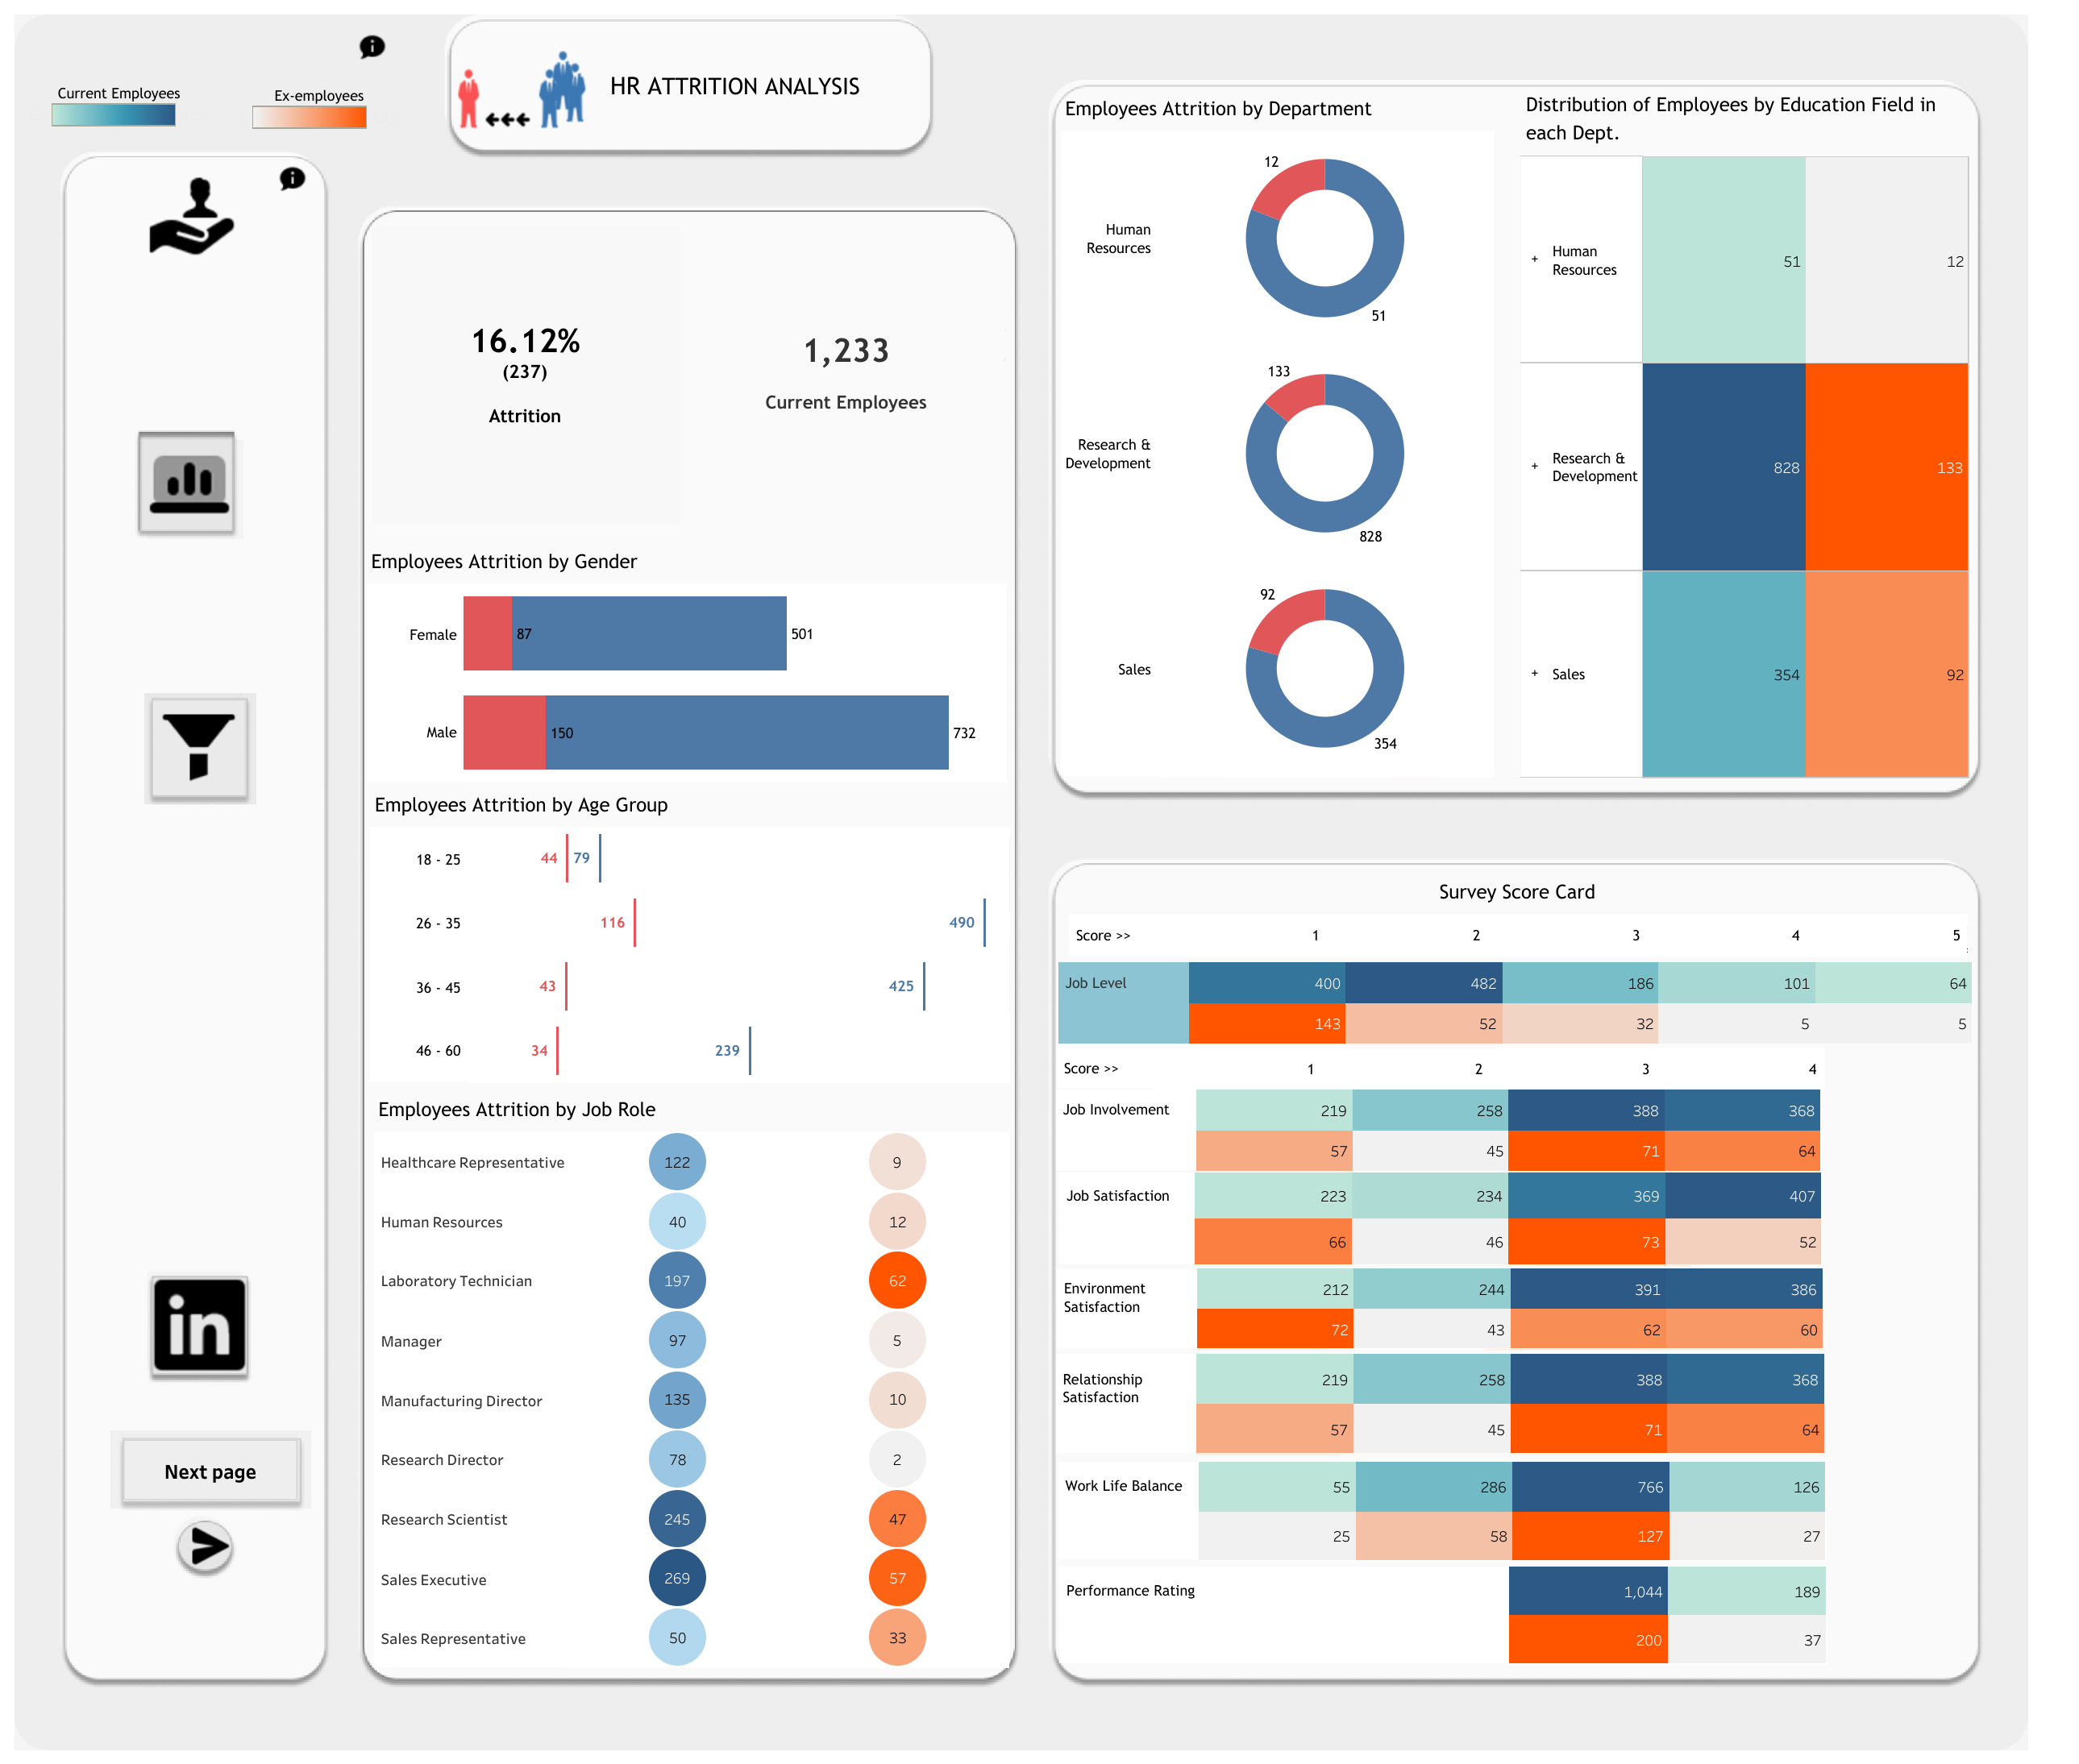

Slide 3
